Slide 1
G K SRUJANA
Final Project

Slide 2
PROJECT TITLE
KEYLOGGER AND SECURITY

Slide 3
AGENDA
Introduction to the Project
Project overview
Problem statement
Who are the end users
Solution and its value proposition
The ‘wow’ factor in the solution
Modelling
Results and conclusion

Slide 4

INRODUCTION TO THE PROJECT
The project "Keylogger and Security" focuses on understanding the threat posed by keyloggers—malicious programs that secretly record every keystroke made on a device, capturing sensitive information like passwords and personal messages. It explores a range of security solutions designed to protect against these threats, including antivirus software, firewalls, anti-keylogging tools, encryption, and two-factor authentication (2FA). The goal of this project is to highlight the importance of a multi-layered security approach to safeguard personal and financial information from cyber threats, ensuring a secure and confident digital experience for users.

Slide 5
PROJECT OVERVIEW
Keyloggers silently record keystrokes, posing serious threats by capturing sensitive data such as passwords and personal information. Often deployed as malware, they compromise user privacy and can lead to identity theft. Mitigation strategies include using updated antivirus software, implementing firewalls, monitoring for suspicious behaviors, encrypting sensitive data, and educating users on safe online practices. These measures help prevent unauthorized access and protect against data breaches caused by keyloggers.

Slide 6
PROBLEM STATEMENT
Keyloggers pose a significant threat by covertly recording sensitive keystrokes, such as passwords and financial information, without user consent. The primary challenge lies in the sophisticated nature of keyloggers, which allows them to evade traditional detection methods.
The rapidly evolving landscape of cyber threats, combined with the complexity of modern IT environments, presents a challenge to ensuring comprehensive security. Organizations face difficulties in keeping pace with new attack vectors, securing diverse technological ecosystems, and addressing vulnerabilities arising from human error and limited resources.

Slide 7
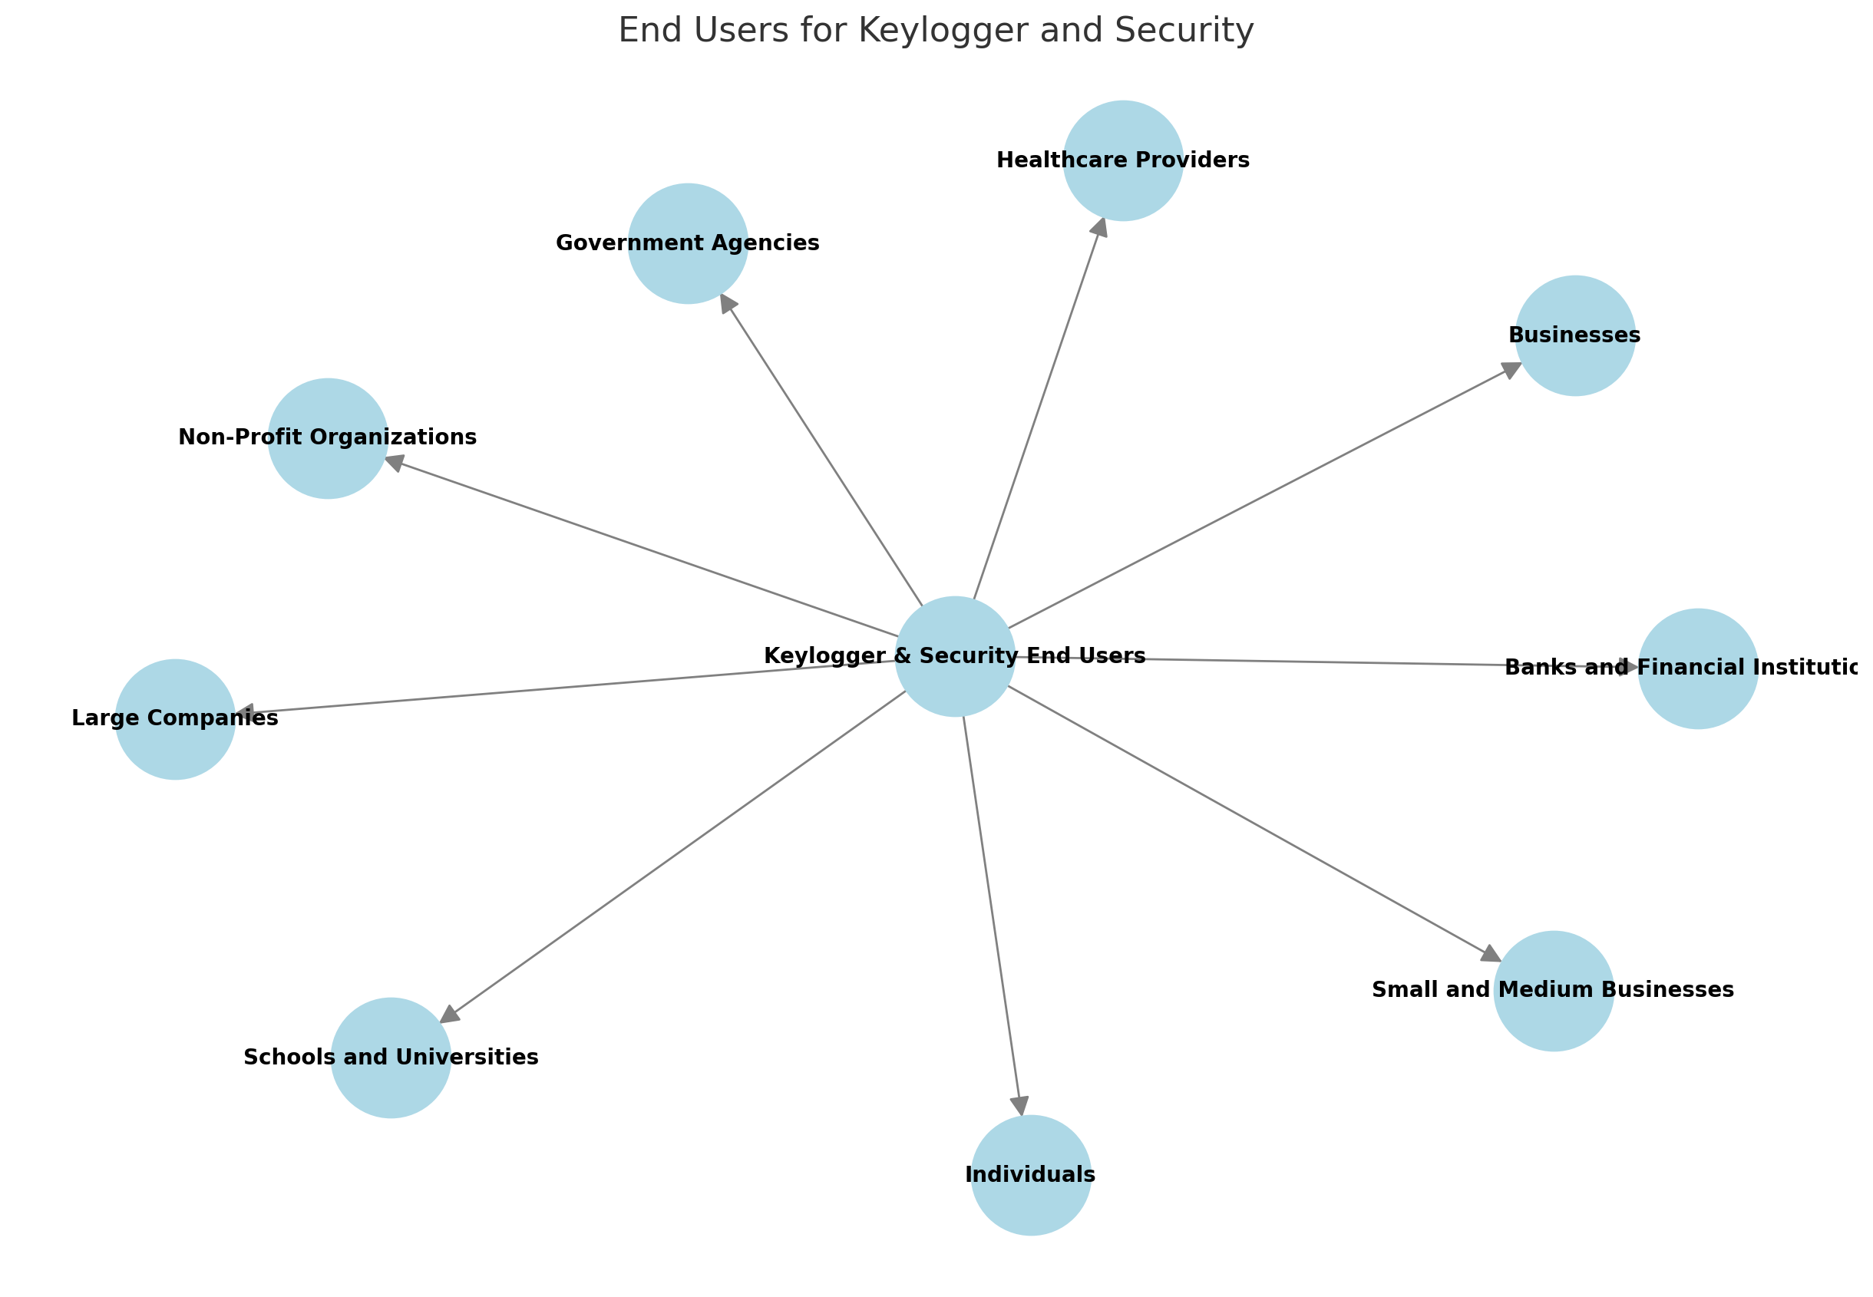
WHO ARE THE END USERS?
End Users for Keylogger and Security:
Individuals
Businesses
Government Agencies
Small and Medium Businesses
Large Companies
Healthcare Providers
Banks and Financial Institutions
Schools and Universities
Non-Profit Organizations

Slide 8
SOLUTION AND ITS VALUE PROPOSITION
Solutions:
Antivirus Software: Install and regularly update antivirus programs to detect and remove keyloggers and malware.
Firewalls: Use firewalls to monitor and block suspicious network traffic, preventing unauthorized access to your devices.
Anti-keylogging Software: Employ tools specifically designed to detect and block keyloggers from capturing keystrokes and sensitive data.
Two-Factor Authentication (2FA): Enable 2FA on your accounts to add an extra layer of security beyond passwords, reducing the risk of unauthorized access even if passwords are compromised.
Value Proposition:
Protection: Ensure the security and privacy of your personal and financial information by preventing keyloggers from stealing sensitive data.
Prevention: Proactively defend against cyber threats by implementing robust security solutions...
Compliance: Meet regulatory requirements and best practices for data protection and cybersecurity.

Slide 9
THE ‘WOW’ FACTOR IN THE SOLUTION
Keyloggers are sneaky programs that secretly record every keystroke you make, capturing sensitive information like passwords and personal messages.
AI-powered antivirus software detects and eliminates keyloggers in real-time, while end-to-end encryption ensures your data stays private. Invisible anti-keylogging software runs seamlessly in the background, and next-generation firewalls provide robust protection.
Biometric two-factor authentication adds an unbreakable layer of security. These cutting-edge tools not only safeguard your information but also make security effortless and future-proof, giving you peace of mind and confidence in your digital activities.

Slide 10
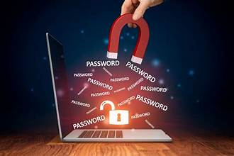
MODELLING
Modeling in the context of keyloggers and security typically refers to creating representations or simulations of keylogger behavior and its impact on system security. Here’s how modeling is relevant in this domain
Resource Utilization: Determines how efficiently the keylogger operates without impacting system performance.
Optimization Techniques: Improves logging efficiency through batch processing or data compression.

Slide 11
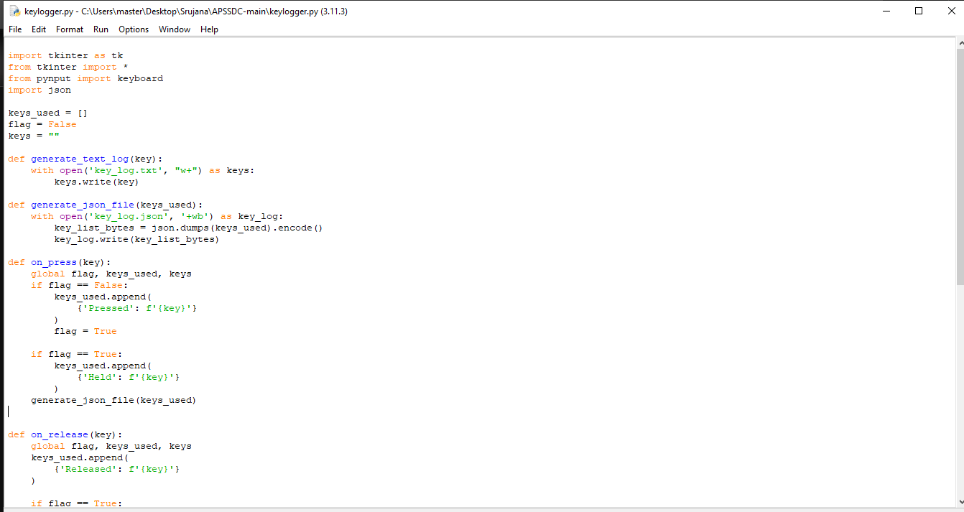

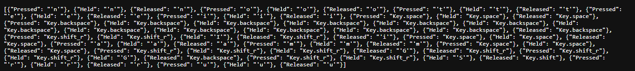
OUTPUT

Slide 12
RESULTS AND CONCLUSION
The project on keyloggers and security reveals that keyloggers are covert programs designed to steal sensitive information by recording keystrokes. To effectively combat this threat, a combination of security solutions is essential. These include antivirus software to detect and remove malware, firewalls to block unauthorized access, anti-keylogging software to prevent keystroke capture, encryption to secure data, and two-factor authentication (2FA) for added protection. Implementing these measures provides a robust defense, ensuring the security and privacy of personal information. This comprehensive approach not only safeguards against keyloggers but also offers users peace of mind and confidence in their digital interactions.

Slide 13
PROJECT LINK
https://github.com/gksrujana03/keylogger.git

Slide 14
THANK YOU

